Slide 1
Cloud Computing 2016 Chapter 5 IaaS
Prof. E.B.Fernandez

Slide 2
System architecture for IaaS
A User creates one or more Accounts in order to use the Provider’s infrastructure. The Provider is composed of a Hypervisor, Hardware (server, storage and network), and DNS (Domain Name System). The Virtual Machine Monitor (VMM) creates Virtual Machines (VM) and assigns their instances to the users who requested them. When the instance is launched, it is assigned to a physical server and given other hardware resources. The Virtual Machine passes system calls to the Virtual Machine Monitor which executes those calls in the Hardware.

Slide 3
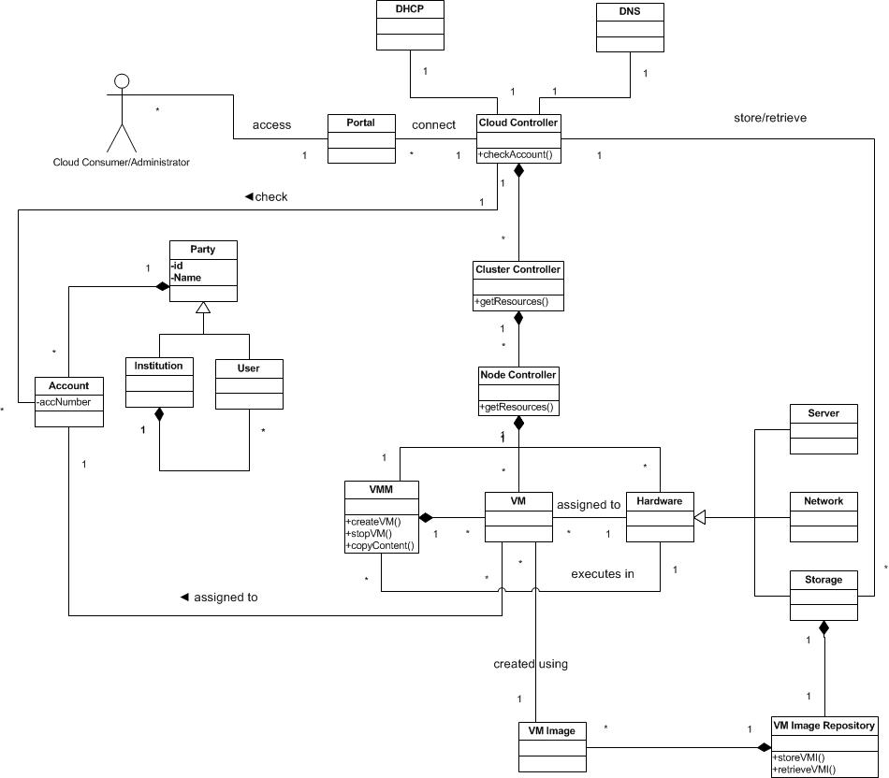

Slide 4
Use-Cases: describing how the user will use the system
A use case is a typical sequence of actions (activities) that a user performs in order to complete a given task
The objective of use case analysis is to model the system from the point of view of
… how users interact with this system
… when trying to achieve their objectives.
It is one of the key activities in requirements analysis
A use case model consists of
a set of use cases
an optional description or diagram indicating how they are related

Slide 5
Use Case Create a VM
UC1: Create a Virtual Machine for a user
Summary: The Provider creates a Virtual Machine for a user.
Actor: User
Precondition: The user must have an account with the Provider
Description:
The User requests to the Provider to create a virtual machine. He specifies the physical location and the type of the instance.
The Provider checks if the user has an account and redirects the request to the Hypervisor.
The Virtual Machine Monitor creates an instance of the Virtual Machine and assigns it to a server and to the user.
Postcondition: A Virtual Machine is created in the specified location and assigned to a server and to the user.

Slide 6
UC Create a VM

Slide 7
OpenStack
OpenStack is a cloud computing project to provide an infrastructure as a service (IaaS). It is free open source software released under the terms of the Apache License. The project is managed by the OpenStack Foundation, a non-profit corporate entity established in September 2012 to promote, protect and empower OpenStack software and its community.
The technology consists of a series of interrelated projects that control pools of processing, storage, and networking resources throughout a data center—which users manage through a web-based dashboard, command-line tools, or a RESTful API.
Founded by Rackspace Hosting and NASA, OpenStack has grown to be a global software community of developers collaborating on a standard and massively scalable open source cloud operating system. Its mission is to enable any organization to create and offer cloud computing services running on standard hardware.
More than 150 companies joined the project among which are AMD, Brocade Communications Systems, Canonical, Cisco, Dell, Ericsson, Groupe Bull, HP, IBM, Inktank, Intel, NEC, Rackspace Hosting, Red Hat, SUSE Linux, VMware, and Yahoo!

Slide 8
OpenStack components
Compute (Nova)—provides virtual machine management. It is designed to manage and automate pools of computer resources and can work with widely available virtualization technologies
Networking (Neutron)--a system for managing networks and IP addresses
Identity (Keystone)--provides a central directory of users mapped to the OpenStack services they can access
Object storage (Swift)—supports data management using a scalable redundant storage system.
Block storage (Cinder)—provides persistent block-level storage
Image (Glance)—provides discovery, registration, and delivery services for disk and server images
Dashboard (Horizon)—provides administrators and users with a graphical interface (dashboard) to access, provision, and automate cloud-based resources

Slide 9
OpenStack components II
Orchestration (Heat)-- is a service to orchestrate multiple composite cloud applications using templates
Workflow (Mistral)-- is a service that manages workflows using YAML.
Telemetry (Ceilometer)-- provides a Single Point Of Contact for billing systems
Database (Trove)-- is a database-as-a-service provisioning relational and non-relational database engine.
Elastic Map Reduce (Sahara)—manages Hadoop clusters
Bare metal (Ironic)--provisions bare metal machines instead of virtual machines.
Key Manager (Barbican)-- is a REST API designed for the secure storage, provisioning and management of secrets

Slide 10
OpenStack architecture

Slide 11
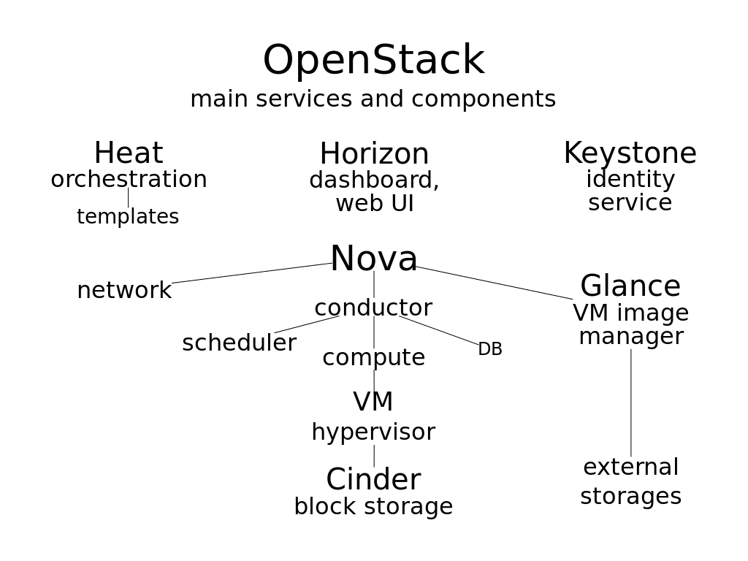
https://en.wikipedia.org/wiki/OpenStack

Slide 12
Hewlett Packard cloud http://h20195.www2.hp.com/v2/GetPDF.aspx/4AA3-4548ENW.pdf
HP CloudSystem Matrix: A private cloud solution that provides infrastructure as a service, as well as basic application deployment and monitoring. This entry offering allows you to provision infrastructure and applications in minutes, not months.
HP CloudSystem Enterprise: For those looking to deploy private and hybrid cloud environments and the full range of service models (IaaS, PaaS, and SaaS). This offering provides a single service view of the client’s environments, from private cloud to public clouds to traditional IT, with advanced application-to-infrastructure lifecycle management.
HP CloudSystem Service Provider: Public or hosted private cloud designed for service providers to provide a public cloud infrastructure as a service (IaaS) and software as a service (SaaS), including aggregation and management of those services.

Slide 13
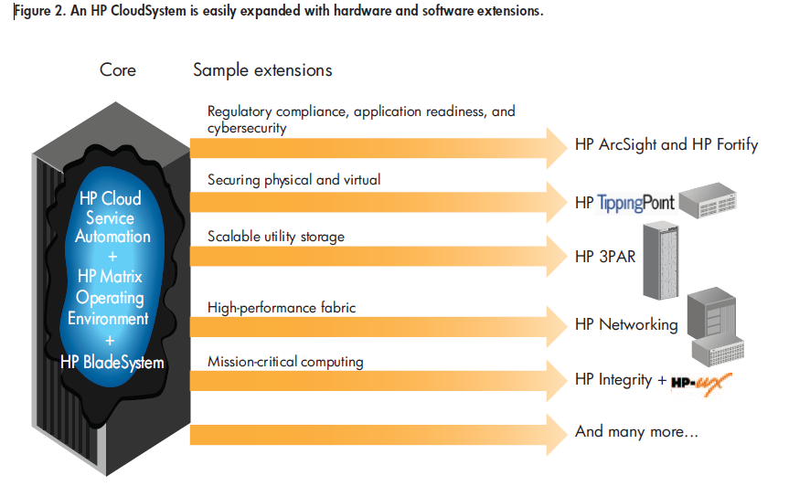

Slide 14
HP Cloud Maps
These provide tools and best practices that enable CloudSystem to quickly and easily create service catalogs for various kinds of common application environments from major vendors such as Oracle, SAP, and Microsoft®.
Cloud Maps can substantially reduce the time and effort needed to develop a catalog of CloudSystem services.
The most important capabilities for clouds are a self-service portal; a pool of shared resources; automated provisioning, flexing, and release of those resources; a facility to meter and charge for usage; and ubiquitous access.

Slide 15
HPE Helion
HPE Helion is an enterprise cloud platform by HP consisting of hardware, software, and services hosted in the private, public, and hybrid cloud. HP Helion was announced and launched in May 2014. The platform is designed to compete with similar enterprise services by Amazon, Google, and IBM but it was just closed down.
OpenStack® technology. Based on Eucalyptus architecture.

Slide 16
VMWare
VMware, Inc.--founded in 1998 and based in Palo Alto, CA, USA. It is majority owned by EMC Corporation.
VMware's desktop software runs on Microsoft Windows, Linux, and Mac OS X, while VMware's enterprise software hypervisors for servers, VMware ESX and VMware ESXi are bare-metal embedded Hypervisors that run directly on server hardware without requiring an additional underlying OS.
VMware software provides a completely virtualized set of hardware to the guest operating system. VMware software virtualizes the hardware for a video adapter, a network adapter, and hard disk adapters. The host provides pass-through drivers for guest USB, serial, and parallel devices.
In this way, VMware virtual machines become highly portable between computers, because every host looks nearly identical to the guest. In practice, a system administrator can pause operations on a virtual machine guest, move or copy that guest to another physical computer, and there resume execution exactly at the point of suspension.
Alternately, for enterprise servers, a feature called VMotion allows the migration of operational guest virtual machines between similar but separate hardware hosts sharing the same storage. Each of these transitions is completely transparent to any users on the virtual machine at the time it is being migrated.

Slide 17
A look at their page
VMware vSphere is the industry-leading virtualization platform for building cloud infrastructures. vSphere enables you to run your business-critical applications confidently to meet your most demanding service level agreements at the lowest TCO.
The VMware vCloud Suite is a complete, integrated cloud infrastructure solution that simplifies IT operations while delivering the best SLAs for all applications. It helps realize the agility, efficiency and intelligent operations management
Provide optimal performance and disaster protection along with operational and regulatory compliance for every kind of workload.
Notice the adjectives, be skeptical. Require proof of any claim: performance benchmarks, availability statistics, list of security mechanisms,...

Slide 18
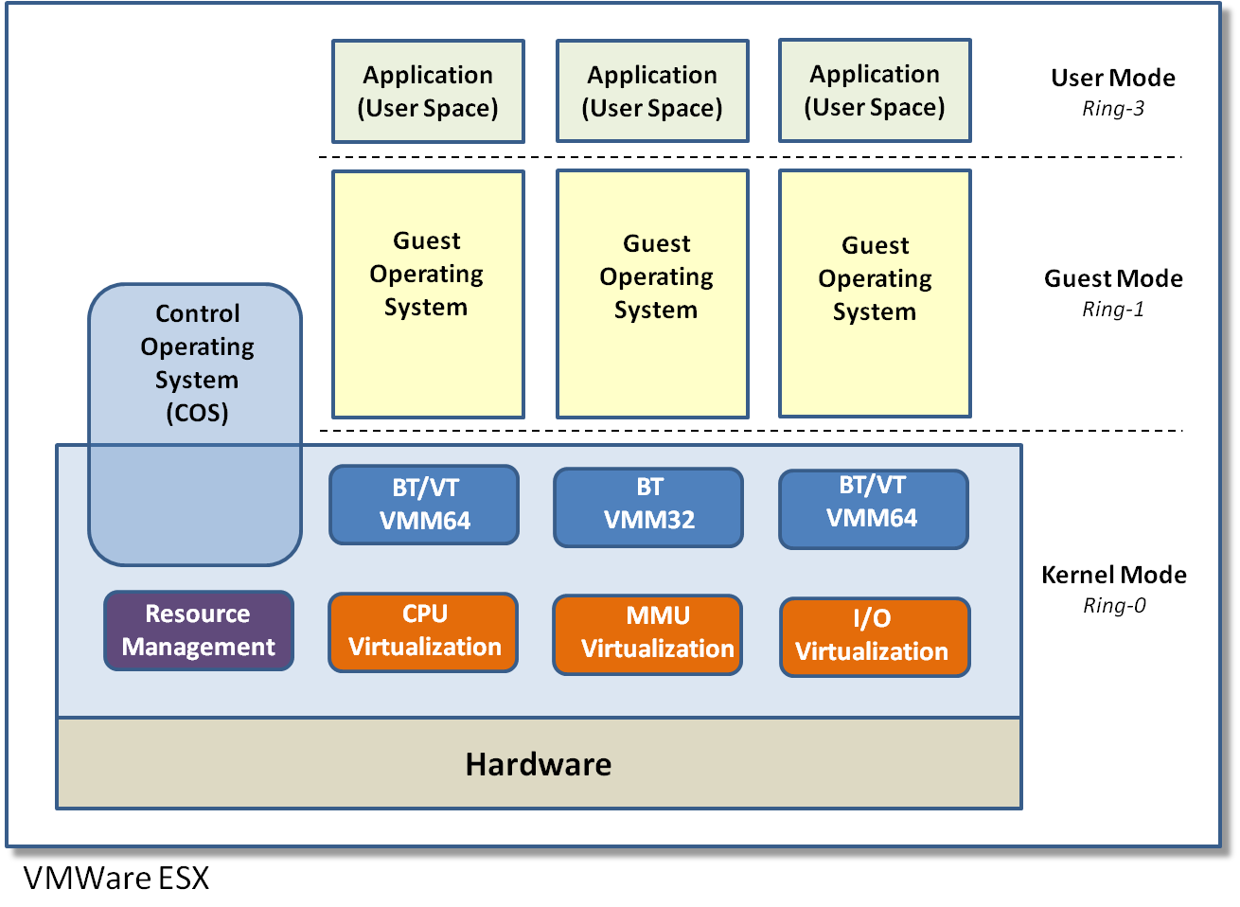
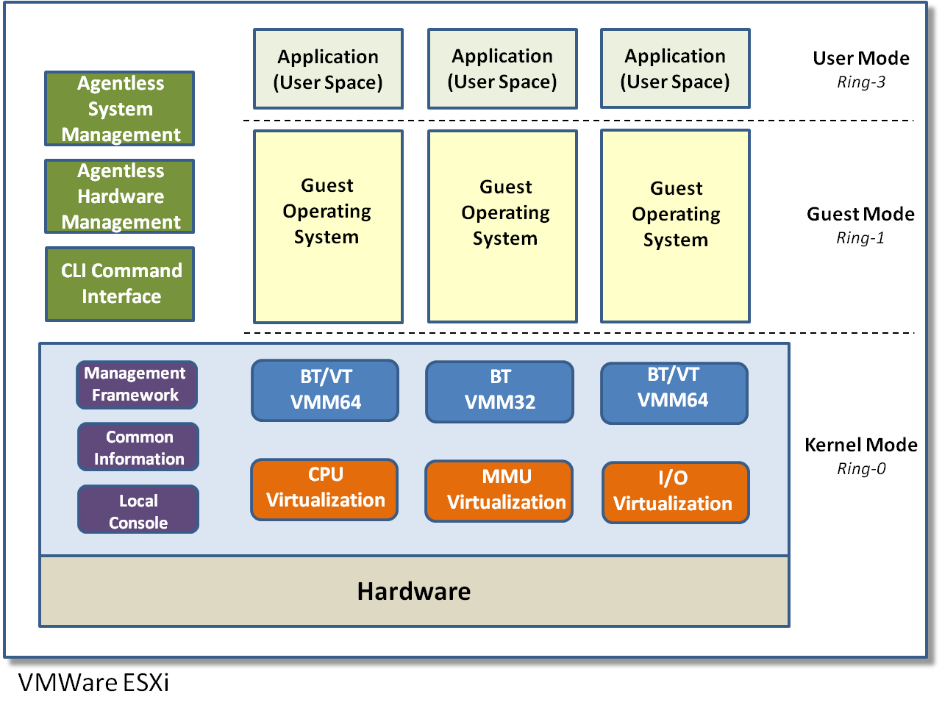
VMWare
VMWare founded in 1998
4 employees -- Now over 9,000 employees
Bought by Dell
Significant innovations in Virtual Machine
Technology –
Operating System
System Management & Monitoring
Deployment & Scalability
Networking
Utilizes Host Operating System for I/O
Pioneered Binary Translation Technology
Each instruction examined
Trap scenarios swapped with sysCall
Pages are cached and marked
If the page is marked native execution
Very high performance execution
No Ring Compression – 0/1/3
Smart Binary Translation Technology
ESX and ESXi are bare metal hypervisors

Slide 19
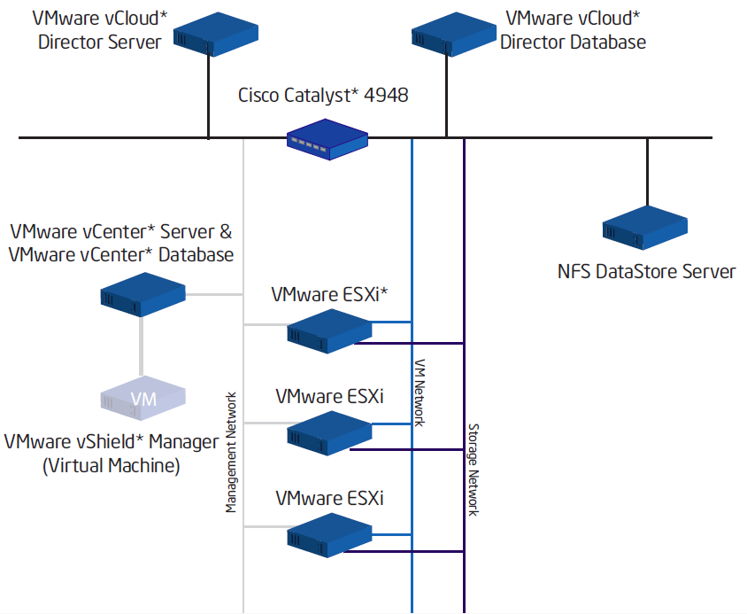

Slide 20
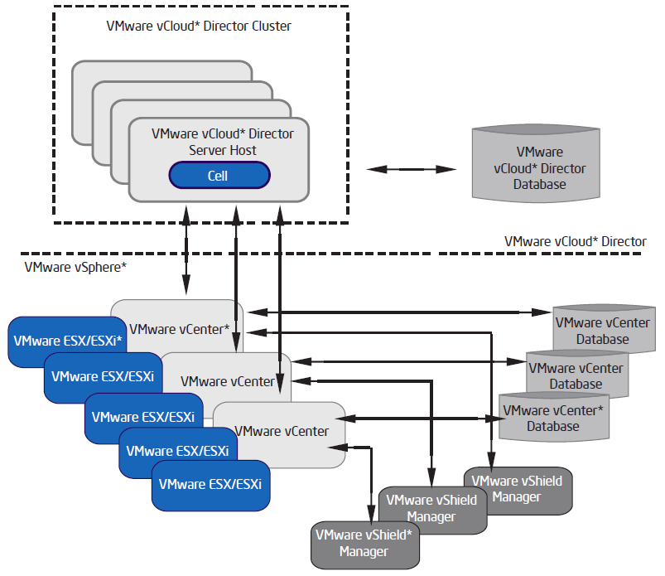

Slide 21
Xen
Xen is a VMM for IA-32, x86-64, Itanium and ARM architectures.
The University of Cambridge (UK) Computer Laboratory developed the first versions of Xen; the Xen community develops and maintains Xen as free software, licensed under the GNU General Public License (GPLv2).
The Xen VMM is the lowest and most privileged layer. Above this layer come one or more guest operating systems, which the hypervisor schedules across the physical CPUs.
The first guest operating system, called in Xen terminology "domain 0" (dom0), boots automatically when the hypervisor boots and receives special management privileges and direct access to all physical hardware by default.
The system administrator can log into dom0 in order to manage any further guest operating systems, called "domain U" (domU) in Xen terminology.

Slide 22
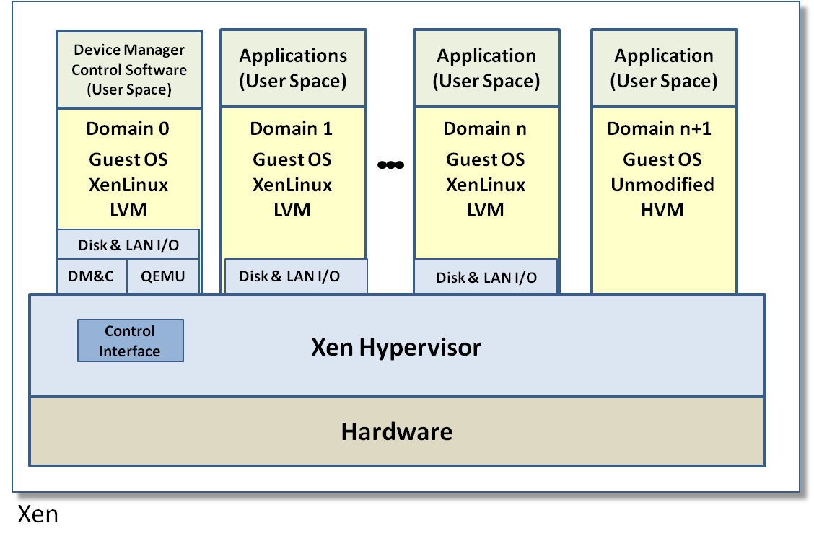
Xen
One of the first high performance VM
Technologies
Owned by Citrix and now called XenServer
Retains its open source model
Hybrid Paravirtualized Hypervisor
Initially Linux only but with Intel VT now can run any x86 guest operating system
Utilizes a host OS to manage I/O.
Very simple and thin Hypervisor
Excellent I/O driver support
Does some I/O optimization for NIC and HDD drivers
Fastest Linux VM Architecture

Slide 23
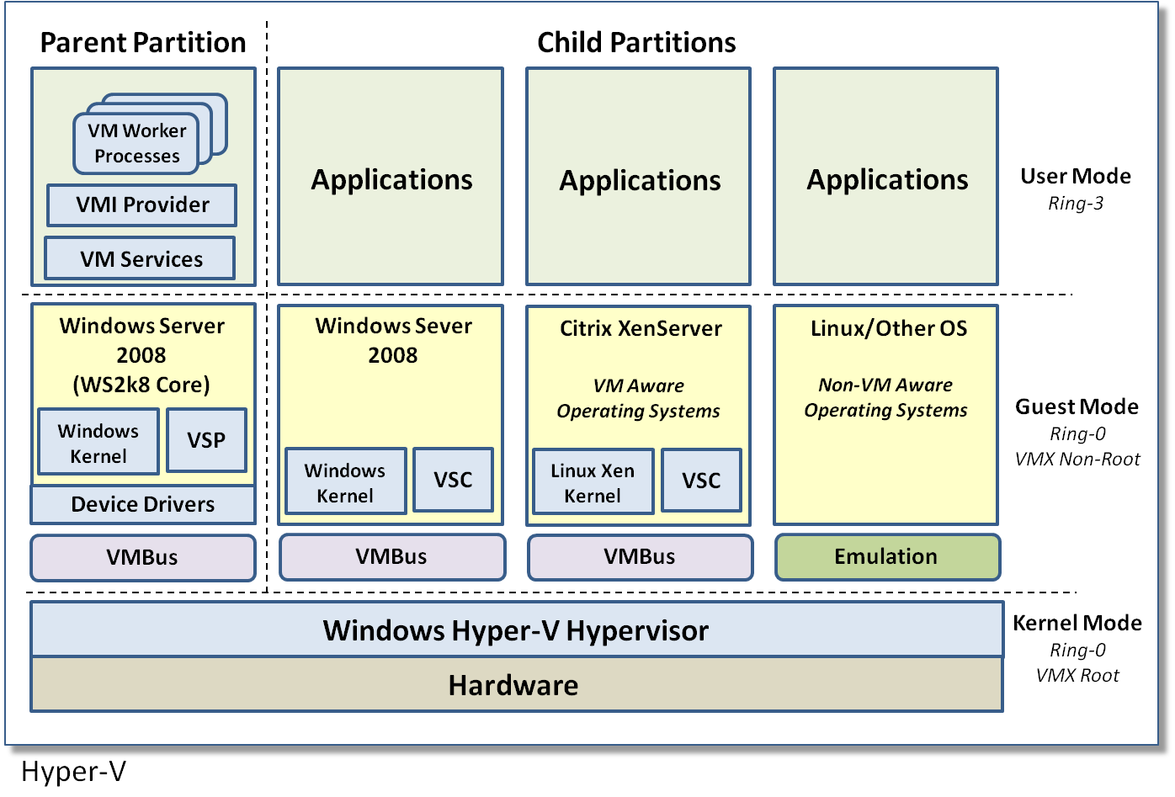
Hyper-V
Microsoft’s Hypervisor for Windows
Server 2008. Hyper-V has since been
released with every version of
Windows Server
Considered a Hybrid Paravirtualized VM
Modified Win Server 2008 OS
Modified Citrix XenServer OS
Intel VT for other OS’s
Utilizes Parent/Child Partition
Parent Partition is Host OS
Child Partition is Guest OS’s
Parent Partition provides I/O driver support
Technology innovations
Utilizes VT root/non-root only when necessary
sysCall OS substitution
VMBus for high performance I/O – NIC’s and HDD

Slide 24
Microsoft Hyper V
Hyper-V supports isolation in terms of a partition. A partition is a logical unit of isolation, supported by the hypervisor, in which operating systems execute. A hypervisor instance has to have at least one parent partition, running Windows Server 2008. The virtualization stack runs in the parent partition and has direct access to the hardware devices. The parent partition then creates the child partitions which host the guest OSs. A parent partition creates child partitions using the hypercall API
A virtualized partition does not have access to the physical processor and does not handle its real interrupts. Instead, it has a virtual view of the processor and runs in Guest Virtual Address, which might not necessarily be the entire VAS. A hypervisor could choose to expose only a subset of the processors to each partition. The hypervisor handles the interrupts to the processor, and redirects them to the respective partition using a logical Synthetic Interrupt Controller (SynIC).
Hyper-V (released in June 2008) exemplifies a type 1 product that can be mistaken for a type 2. Both the free stand-alone version and the version that is part of the commercial Windows Server 2008 product use a virtualized Windows Server 2008 parent partition to manage the Type 1 Hyper-V hypervisor. In both cases the Hyper-V hypervisor loads prior to the management operating system, and any virtual environments created run directly on the hypervisor, not via the management operating system.

Slide 25
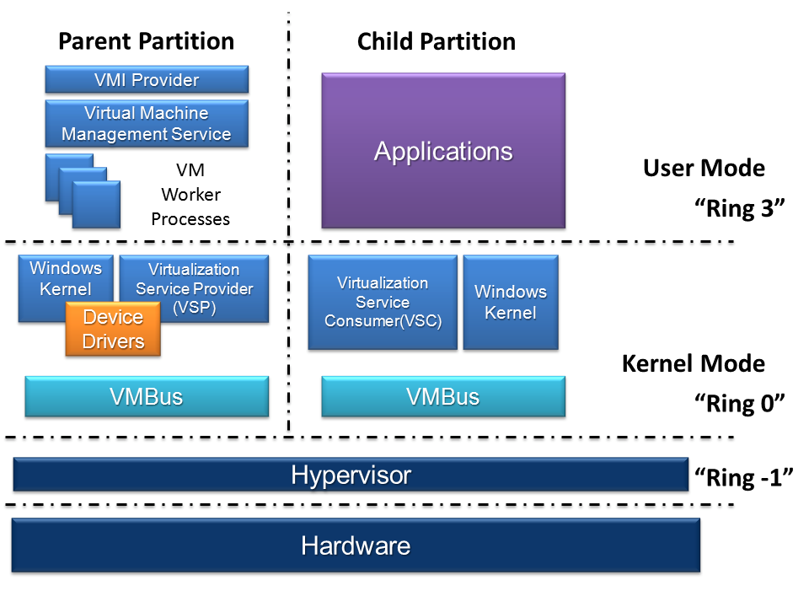

Slide 26
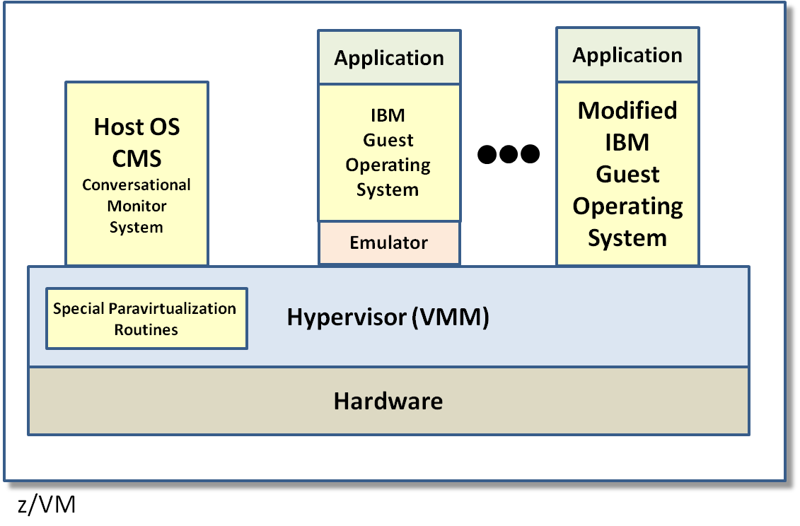
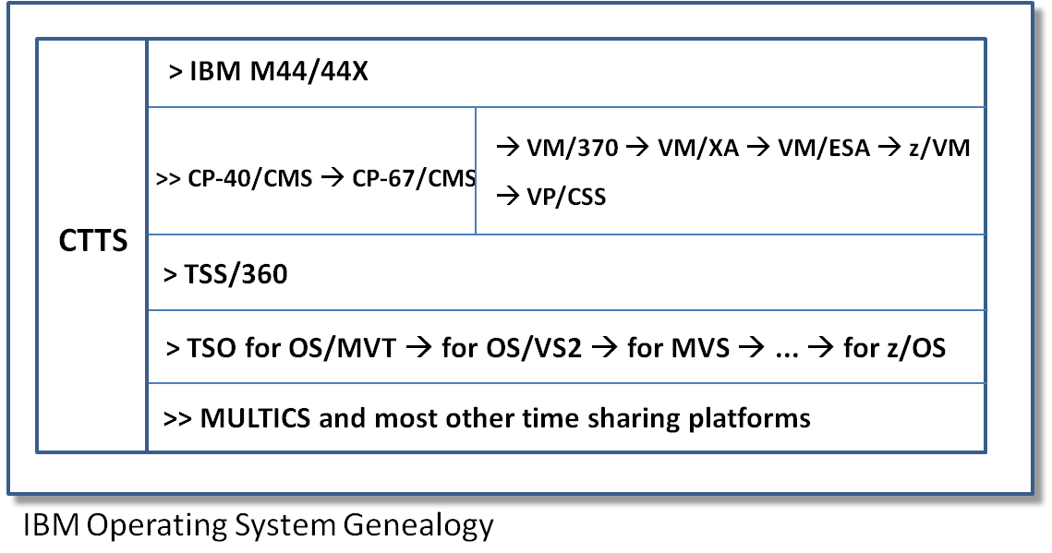
z/VM
Combination Paravirtualized and hardware
emulation architecture
IBM Linux Based Hypervisor, v. 6.4 now
Supports OpenStack
Focused on Linux and Legacy Operating Systems
Intel VT Technology for Linux OS’s
Paravirtualization for IBM’s OS’s
Hardware Emulation for legacy OS’s
Supports a number of legacy & New OS’s
VSE MVS VM TPF
Z/OS z/TPF z/VSE z/VM
Supports ESA, XA, and XC hardware
platforms
Strategy supports holding on to existing customer
base as well as future VM platform

Slide 27
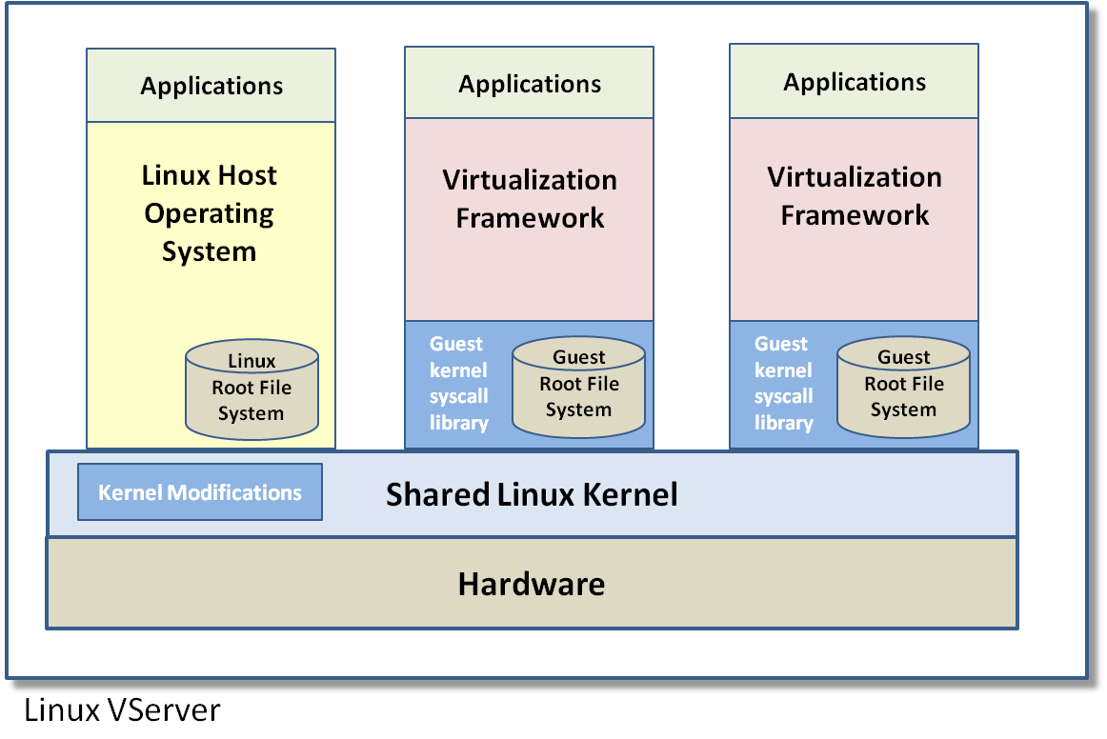
Linux V/Server
Linux VServer one of the more
interesting VM architectures
Exploits the concept of Linux root isolation
Uses a single Linux kernel – no VMM
Host Linux OS runs in root
Guest OS run in guest root mode
To the guest OS they appear to have root privilege
Linux file system provides data isolation
Kernel handles each guest OS as just another thread
Some modifications required to the kernel to handle host/guest root mode
Although each guest VM is transparent it does favor a servlet programming style
All guest VMs must be the same Linux guest OS, no mixing of guest OS’s (container)

Slide 28
Linux-VServer
Linux-VServer is a virtual private server implementation that was created by adding OS-level virtualization to the Linux kernel. It is developed and distributed as open-source software.
Linux-VServer is a jail mechanism in that it can be used to securely partition resources on a computer system (such as the file system, CPU time, network addresses and memory) in such a way that processes cannot mount a denial-of-service attack on anything outside their partition.
Each partition is called a security context, and the virtualized system within it is the virtual private server. A chroot-like utility for descending into security contexts is provided. Booting a virtual private server is then simply a matter of kickstarting init in a new security context; likewise, shutting it down simply entails killing all processes with that security context. The contexts themselves are robust enough to boot many Linux distributions unmodified, including Debian and Fedora.
Virtual private servers are commonly used in web hosting services, where they are useful for segregating customer accounts, pooling resources and containing any potential security breaches.

Slide 29
Solaris containers
http://www.oracle.com/technetwork/server-storage/solaris/containers-169727.html
Introduced in 2005 by Sun for its Solaris 10 OS, now in OpenSolaris and Solaris 11
Implementation of OS-level virtualization
A Solaris Container is the combination of system resource controls and the boundary separation provided by zones
Zones act as completely isolated virtual servers within a single operating system instance.
Each zone has its own node name, virtual network interfaces, and storage assigned to it
By consolidating multiple sets of application services onto one system and by placing each into isolated virtual server containers, system administrators can reduce cost and provide all the same protections of separate machines on a single machine.

Slide 30
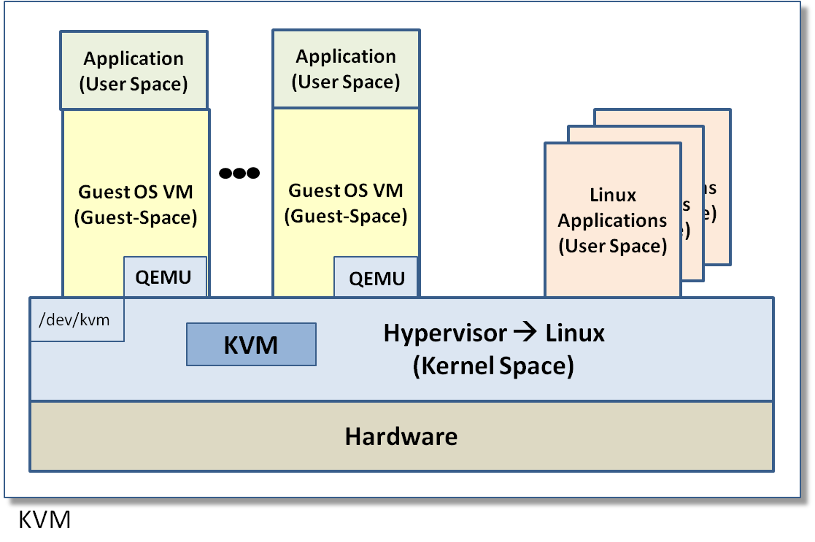
KVM
Linux Open Source VM distribution
Optimized for Linux but runs other OS’s
Utilizes Intel VT VMX Root 0/Non-Root 0
Operation – R0/NR0/4
KVM module is addition to Linux 2.6.2 – Manages virtual memory between
Hypervisor (Linux Kernel) and guest operating systems utilizing Shadow Pages
Utilizes QEMU for non-Linux Operating Systems – I/O Emulation
Utilizes Linux drivers for all I/O – Excellent driver compatibility and availability
Can only run x86 based operating systems

Slide 31
Kernel-based Virtual Machine (KVM)
A virtualization infrastructure for the Linux kernel. KVM supports native virtualization on processors with hardware virtualization extensions.
KVM originally supported x86 and x86-64 processors and has been ported to S/390, PowerPC, and IA-64. An ARM port is in progress.
A wide variety of guest operating systems work with KVM, including many flavours of Linux, BSD, Solaris, Windows, Haiku, ReactOS, Plan 9, and AROS Research Operating System. A modified version of QEMU can use KVM to run Mac OS X.
Limited paravirtualization support is available for Linux and Windows guests using the VirtIO framework. This supports a paravirtual Ethernet card, a paravirtual disk I/O controller, a balloon device for adjusting guest memory usage, and a VGA graphics interface using SPICE or VMware drivers.
KVM uses SeaBIOS.
Linux 2.6.20 (released February 2007) was the first to include KVM.
KVM has also been ported to FreeBSD and Illumos as a loadable kernel module

Slide 32
QEMU (Quick Emulator)
QEMU is a free and open-source hosted hypervisor that performs hardware virtualization
QEMU is a hosted virtual machine monitor: It emulates CPUs through dynamic binary translation and provides a set of device models, enabling it to run a variety of unmodified guest Oss.
QEMU can also be used purely for CPU emulation for user-level processes, allowing applications compiled for one architecture to be run on another.

Slide 33
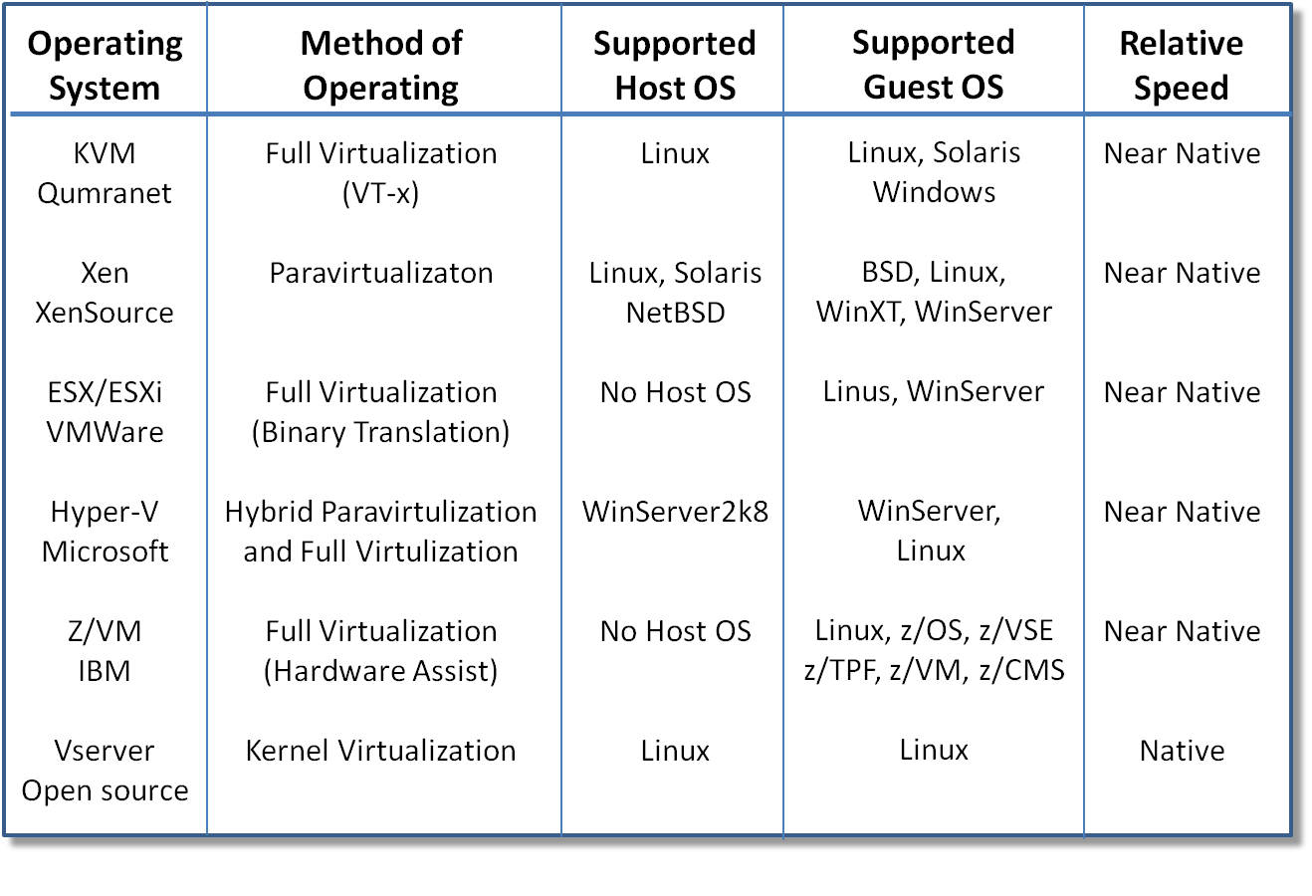
Virtual Machine Comparisons

Slide 34
Huawei
Huawei Technologies Co. Ltd. is a Chinese multinational networking and telecomm. equipment, and services company headquartered in Shenzhen, Guangdong, China.
It is the largest telecommunications equipment maker in the world, having overtaken Ericsson in 2012
Huawei has over 140,000 employees, around 46% of whom are engaged in research and development
Huawei is organized around three core business segments:
Telecom Carrier Networks, building telecommunications networks and
services
Enterprise Business, providing equipment, software and services to
enterprise customers, e.g. Government Solutions (Cloud systems)
Devices, manufacturing electronic communications devices

Slide 35
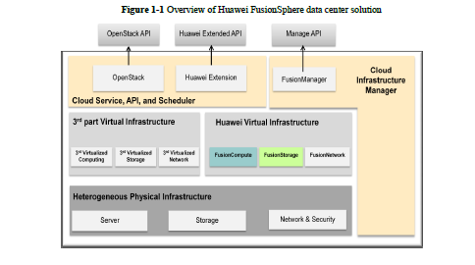

Slide 36
Parallels http://en.wikipedia.org/wiki/Parallels,_Inc.
Parallels is best known for its Intel-based Mac product Parallels Desktop for Mac. First released June 25, 2006, Parallels Desktop for Mac is a hardware emulation virtualization software that uses a lightweight hypervisor to enable users to run Windows, Linux and other operating systems simultaneously with Mac OS X on their Intel based Macs.
First release June 17, 2008, Parallels Server for Mac is a hypervisor-based server virtualization software that enables IT managers to run multiple Windows, Linux and Mac OS X Server operating systems on a single Mac Xserve. As of its release, it is currently the only server virtualization solution for the Mac OS X server platform and that allows users to virtualize Mac OS X Leopard Server.
Parallels Virtuozzo Containers is an operating system-level virtualization product designed for large-scale homogeneous server environments and data centers. Parallels Virtuozzo Containers is compatible with x86, x86-64 and IA-64 platforms. Parallels Virtuozzo Containers was first released under Parallels' former parent company SWsoft. The Linux version was released in 2001 while the Windows version was released in 2005.

Slide 37
Mobile virtualization
Around 2008, the mobile industry became interested in using the benefits of virtualization technology for cell phones and other devices like tablets, netbooks and (M2M) modules.
With mobile virtualization, mobile devices can be manufacture more cheaply through the reuse of software and hardware, which shortens development time.
Allows running in the same phone applications written for different operating systems (real time and regular)and can separate trusted from untrusted applications
First done in the Motorola Evoke QA4 phone in 4/2009 by OK Labs (Australia)(Gernot Heiser).

Slide 38
Mobile virtualization II
Semiconductor vendors such as ST-Ericsson adopted mobile virtualization as part of their low-cost Android platform strategy.
ARM processors and similar can run hypervisors or microkernels and can support mobile devices using a single-core or a multi-core processor. In September 2010, ARM started supporting a mobile virtualization extension in its ARM Cortex A-15 processor.
VmWare demonstrated how it could run a separate instance of Android in a virtual machine that is hosted by an Android-based smartphone. VMware demonstrated this capability on LG's Revolution VS910 (1/2012). They became available in 2013 in LG Intuition and Motorola Razr M. Also used in Samsung phones

Slide 39
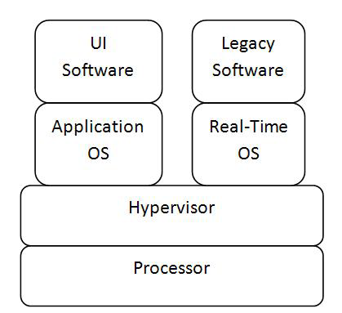
Virtualization architecture for embedded systems http://www.eit.lth.se/fileadmin/eit/project/142/virtApproaches.pdf

Slide 40
L4 Microvisor
L4 Microvisor from OK Labs (Australia)
Runs as 'host' OS
Microkernel architecture
Limited execution in kernel mode
Real-time capabilities for communication stack and media streaming
seL4 mathematically proven correct, 08/09

Slide 41
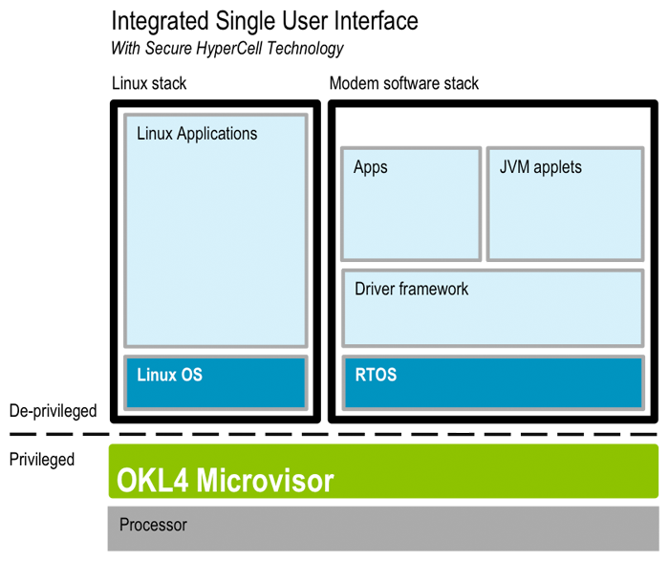
L4 Microvisor

Slide 42
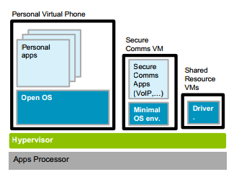
Secure communications in standard phone

Slide 43
The Microkernel pattern (www.vico.org)
"The Microkernel architectural pattern applies to software systems that must be able to adapt to changing system requirements. It separates a minimal functional core from extended functionality and customer-specific parts. The microkernel also serves as a socket for plugging in these extensions and coordinating their collaboration." (Buschmann, F., R. Meunier, H. Rohnert, P. Sommerlad, and M. Stal. Pattern-Oriented Software Architecture: A System Of Patterns. West Sussex, England: John Wiley & Sons Ltd., 1996)
The microkernel includes functionality that enables other components running in separate processes to communicate with each other. It is also responsible for maintaining system-wide resources such as files or processes. In addition, it provides interfaces that enable other components to access its functionality.

Slide 44
Microkernel
9/21/2016
44

Slide 45
Reducing kernel mode execution
If only a few critical functions run in kernel mode security and reliability improve
Hypervisors and microvisors run in kernel mode but all other programs run in user mode
Improves performance also

Slide 46
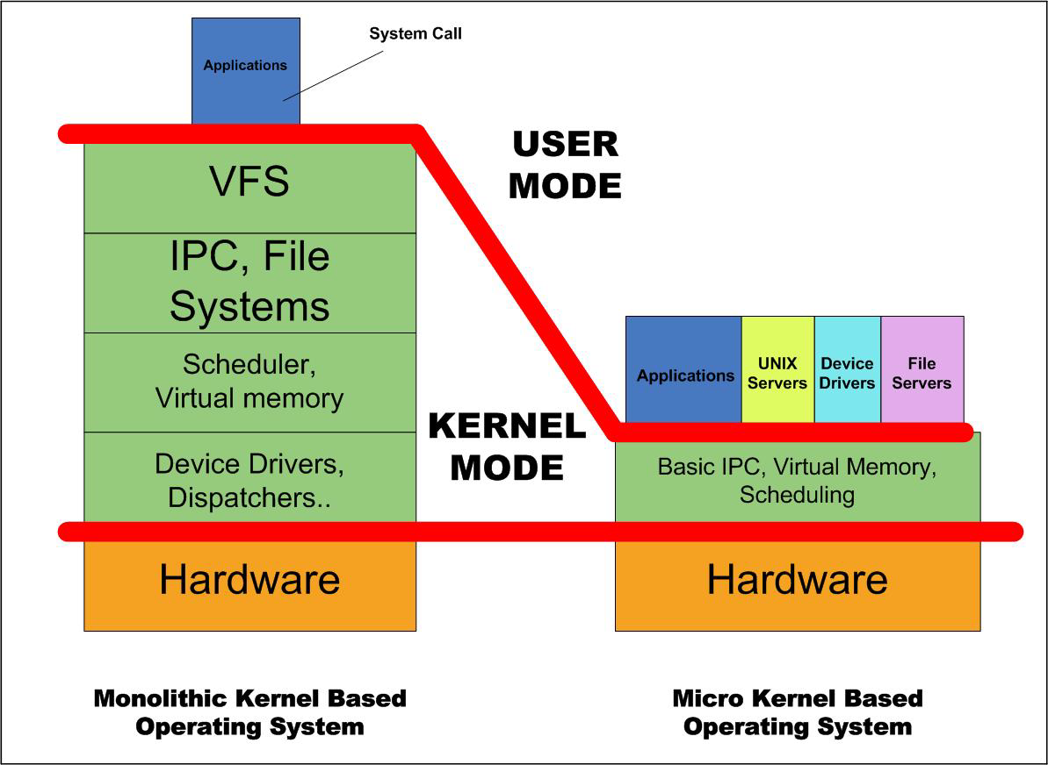

Slide 47
Example for adapter need
We have a text message system that sends, receives, and manipulates text messages. We want to handle also XML messages so that we can handle more complex transactions. We purchased an off-the-shelf tool, XmlMessage, which manipulates XML messages. The problem is that these two interfaces are incompatible: XmlMessage expects an XML message and TextMessage does not know how to create an XML message.

Slide 48
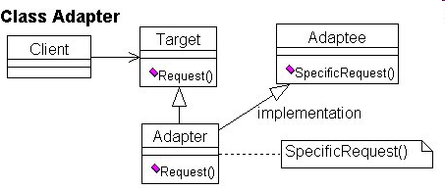
Class Adapter

Slide 49
Adapter (www.vico.org)
Intent: The Adapter pattern converts the interface of an existing class into a more convenient interface, expected by a client.
Also Known As: Wrapper
Applicability: An existing class may have an interface that doesn’t match a new application. We may make its interface look like the new application by adapting it. Now the clients see a class according to the new application; calls to that interface are passed over to the old class.
GOF book gives sample code.

Slide 50
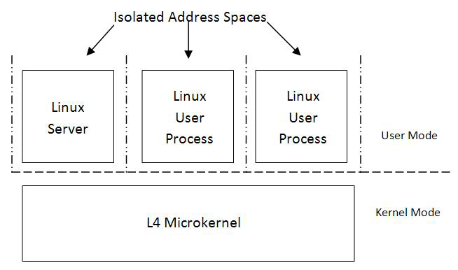
L4 Linux architecture

Slide 51
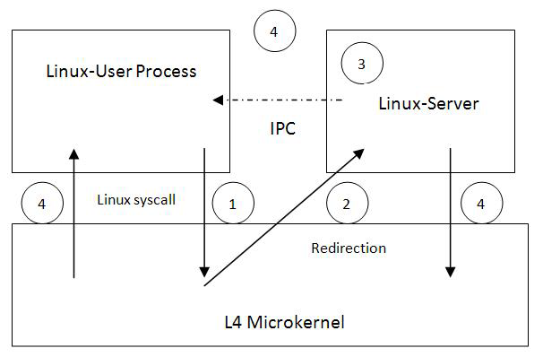
System call in L4 Linux

Slide 52
ARM
The ARM is a 32-bit Reduced-Instruction Set Computer (RISC) (small set of simple instructions, typically one-cycle instructions)
It was known as the Advanced RISC Machine, and before that as the Acorn RISC Machine
The ARM architecture is the most widely used Instruction Set Architecture (ISA) in terms of numbers produced.
They were originally conceived as a processor for desktop personal computers
The relative simplicity of ARM processors made them suitable for low power applications. This has made them dominant in the mobile and embedded electronics market

Slide 53
ARM II
ARM processors are used extensively in consumer electronics, including PDAs, mobile phones, digital media and music players, hand-held game consoles, calculators and computer peripherals such as hard drives and routers
As of 2007, about 98 percent of the more than one billion phones sold each year used at least one ARM processor.
As of 2009, ARM processors accounted for approximately 90% of all embedded 32-bit RISC processors
In 2010: over 95% in smartphone market; 10% in mobile computers; 35% in digital TVs and set-top boxes; however, ARM did not have any market share in servers and desktop PCs.
With Microsoft's new ARM-based Windows 8 OS, market research firm IHS predicted that in 2015 23% of all the PCs in the world will use ARM processors.

Slide 54
Intel vs. ARM: The Economist 01/07/12
Intel is starting to get into the smartphone and tablet market, until now dominated by ARM
ARM is starting to get into the server market, now dominated by Intel
Both are also looking at the IoT (Internet of Things): appliances, car controllers, industrial machinery,… Now Renesas Electronics, from Japan, dominates this market
ARM, based in the UK, has 2000 employees; Intel, based in California, has 100,000 employees
ARM specializes in low-power chips

Slide 55
Renesas Electronics Corporation
A Japanese semiconductor manufacturer headquartered in Tokyo. It has manufacturing, design and sales operations in around 20 countries. Renesas is one of the world's largest manufacturers of semiconductor systems for mobile phones and automotive applications. It is the world's largest manufacturer of microcontrollers and the second largest manufacturer of application processors. Renesas is also known for LCD drivers, RF ICs, mixed-signal integrated circuits and system-on-a-chip semiconductors.
In December 2012, INCJ, Japan’s government-backed fund, and the key manufacturing clients decided to invest in the company. Through the investment, Renesas Electronics will secure 150 billion yen as fresh capital by September 2013 and use it for realizing the Smart Society through investment in the microcontroller and Analog & Power semiconductor development, plant improvements, automotive and industrial semiconductor solutions and corporate acquisitions.
In September 2013, Broadcom acquired most of Renesas Mobile Communication.

Slide 56
AONIX
Aonix Perc Ultra SMP 5.4 from Atego supports multi-core ARM processors. Initial testing of this port was done using a four core ARM processor running Linux.
Aonix Perc Ultra® for ARM processors are used now in a number of deployed systems such as in-flight entertainment & cabin management systems and a shipboard defense control application,
Having an advanced real-time virtual machine with the ability to effectively scale across ARM multi-core systems opens many new opportunities.
It supports Java AWT/Swing libraries for embedded platforms
Atego™ is a supplier of industrial-grade, collaborative development tools and runtime environments for engineering complex, mission- and safety-critical architectures, systems, software and hardware.

Slide 57
IBM and the cloud 2012
IBM had two service tiers, under the umbrella name of the IBM SmartCloud.
One, the Enterprise service, is an infrastructure-as-a-service offering similar to those from Amazon Web Services. Customers can deploy Windows or Linux applications in IBM data centers and IBM says it will guarantee 99.5 percent uptime annually.
The other, Enterprise Plus, offers higher levels of security and a 99.9 percent uptime guarantee, plus the option to run virtual machines on dedicated hardware, rather than servers shared with other customers, and the option to use AIX as well Windows and Linux. It also has more flexible management, security, and availability options. IBM will manage just the hardware and hypervisors, for example, or almost any combination of the OS, middleware, application, or entire business process.
AIX is a high-security version of Unix, developed by IBM

Slide 58
IBM plans II
IBM is also offering the products behind the services as a hardware and software package that companies can deploy in their own data centers. It includes numerous Tivoli and Systems Director products, including Tivoli Service Automation Manager and Tivoli Provisioning Manager for Images.
Tivoli Software is the service management brand of the IBM Software Group. IBM purchased Austin-based Tivoli Systems, Inc. on March 4, 1996 and allowed existing executive management to operate Tivoli as a wholly owned subsidiary in the IBM Software Group. (In addition to Tivoli, this IBM division includes WebSphere, Information Management, Lotus Software, Rational Software and Netezza Data Warehouse Appliance)
The biggest challenge for enterprises will be management, according to IBM, in particular the proliferation of virtual machines and software images.
IBM hopes to distinguish itself from other cloud providers by the level of security and management it says it can offer.

Slide 59
Analysis of IBM plans
The Smart Business Cloud - Enterprise is a big step up from IBM's previous pure IaaS offering, the Smart Business Development and Test Cloud. Users can provision stock VMs running Red Hat Enterprise Linux, SUSE Linux Enterprise Server and Microsoft Windows Server, or they can choose from an arsenal of preconfigured software appliances that IBM, in part, manages and that users consume. These include Industry Application Platform, IBM DB2, Informix, Lotus Domino Enterprise Server, Rational Asset Manager, Tivoli Monitoring, WebSphere Application Server, Cognos Business Intelligence and many others.
All of the images and applications being offered from SBC - Enterprise presently run in Amazon’s EC2 environment. Not all of the announced IBM cloud applications run in the IBM compute environment.
Apparently sensitive to its enterprise audience, IBM has taken some pains to offer higher-end features, including access and identity management control, security and application monitoring tools, and VPN and VLAN capabilities, as well as VM isolation. IBM technical support will also be available.
IBM has been a consistent supporter of open source software for the enterprise market and the inclusion of Red Hat Enterprise Linux (RHEL) and SUSE Linux are indications that IBM feels those products have the chops for big customers running Linux. Being based on Linux (Blue Insight) also makes it easy for IBM to port its technology into an Amazon-type network.

Slide 60
IBM News 01/2013
IBM established a global network of eight data centers to supply infrastructure as a service (IaaS) and is now offering SmartCloud Enterprise+ for running production workloads, including SAP applications.
Unlike Amazon.com or Rackspace IaaS, IBM customers will find System Z mainframes and System P servers running AIX in the IBM cloud. That makes SmartCloud more compatible with the workloads of IBM customers. Most other services are based strictly on standard Intel or AMD x86 servers, and it remains difficult to migrate Z series or P series workloads to x86 servers.
IBM's IaaS data centers are in Boulder, Colo.; Raleigh, N. C., Montpellier, France; Ehningen, Germany; Sydney, Australia; Sao Paulo, Brazil; Tokyo; and Toronto. It will add a ninth at mid- year in Barcelona, Spain. The company has previously offered IaaS in the U.S. and Europe.
Offering greater geographic coverage often helps companies find a site in which to store their data. France, Germany and Canada all have regulations on what data may leave the country and what may not.

Slide 61
IBM II (C. Babcock, Information Week)
Unlike Amazon, IBM will let the customer choose to either manage his own workload or let IBM do it, similar to a managed hosting service, for an additional fee.
It will also gear the service to the degree of availability and security desired by the customer. SmartCloud Enterprise+ can have service levels that guarantee availability for operating system-instance from 98.5% to 99.9%.
IBM claimed it saw an 80% increase in its cloud revenues in 2012. The company is well on its way toward achieving its planned $7 billion in cloud revenues by 2015.

Slide 62
Oracle IaaS (01/29/13)
An infrastructure-as-a-service (IaaS) plan may enable the company to boost use of the company's hardware while also bolstering cloud subscription numbers.
Oracle IaaS may be a win-win for customers, too, so long as their idea of infrastructure-as-a-service is building out private-cloud infrastructure in their own data centers.
Oracle IaaS lets you deploy Exadata, Exalogic, Exalytics or Sparc SuperCluster servers on premises while paying for use of the hardware through monthly subscription fees. There's a semi-elastic capacity-on-demand option where you can pay for about 75% of the hardware's CPU capacity with the option of tapping into the other 25% by paying additional monthly fees as needed.

Slide 63
Oracle products
Oracle Exadata is a database appliance with support for both OLTP (transactional) and OLAP (analytical) database systems.^{[1]} It was initially designed in collaboration between Oracle Corporation and Hewlett Packard, where Oracle designed the database, operating system (based on the Oracle Linux distribution), and storage software whereas HP designed the hardware for it.
Exalogic is a computer appliance made by Oracle Corporation, commercially available since 2010. It is a cluster of x86-64-servers running Oracle Linux or Oracle Solaris preinstalled. Its full trade mark is Oracle Exalogic Elastic Cloud X2-2 to use in building blocks in clouds
Exalitics is an enterprise platform, in-memory analytics software, and hardware optimized to work together
SPARC SuperCluster combines the new SPARC T4 processor, Oracle Solaris 11, Oracle Exadata storage, and the accelerated middleware processing of the Oracle Exalogic Elastic Cloud.

Slide 64
Oracle II
The "as a service" element of the plan is the free inclusion of Oracle PlatinumPlus services that promise ongoing systems monitoring by the vendor to identify system performance and reliability problems, security and compliance issues, and deviations from Oracle best practices and recommended configurations.
Oracle's software-as-a-service (SaaS) offerings, including ERP, sales and marketing, human capital management, talent management, and customer service, had new releases since October of 2013.

Slide 65
Oracle III
In addition, Oracle platform-as-a-service (PaaS) database and Java offerings have been released. Several new PaaS offerings, including storage, messaging, virtual-compute and developer services, are now available.
Oracle claims to have more than 10,000 customers and 25 million users in the cloud. The customer count seems reasonable, given Oracle's many cloud acquisitions, but the user count seems astronomical.
Salesforce.com, widely acknowledged to be the cloud computing market-share leader, reported roughly 104,000 customers and 2.1 million subscribers as of mid-2011.

Slide 66
Oracle IV
Hurd noted that nine of the top 10 SaaS vendors use Oracle database, so perhaps he's including customers of those OEMs in the count? Oracle did not respond to a request for details on these stats in time for publication.
Responding to a question from a reporter, Hurd said Oracle's $7.5 billion 2009 acquisition of Sun Microsystems had already paid for itself. "The cash flow has far exceeded the purchase price," he said, citing revenue streams related to Java, software support and hardware.
Oracle-Sun hardware sales have steadily declined since the acquisition, yet Oracle has consistently said that decline is part of a planned shift away from low-margin commodity hardware and toward higher-margin sales of Exa-series and Sparc engineered systems -- the very products featured in the new IaaS plan.

Slide 67
Main players in the IaaS space (10/14)
Amazon Web Services (AWS), which offers a full range of compute and storage products
Windows Azure, especially appropriate for those used to working with Microsoft platforms
HP Helion, which leverages HP’s enterprise success to integrate existing IT infrastructure with private and public cloud services
Google Compute Engine, which leverages its reputation and lead in Search, and its famously efficient cloud data centers, to extend competition to the infrastructure space as well.
Rackspace Open Cloud, which has a strong focus on customer service
VMware Hybrid Cloud Services, which leverages VMware’s success in virtualization to offer a solution spanning from Data Center to Public Cloud
Next is Gartner’s Magic Quadrant (ability to execute (y) vs completeness (x)

Slide 68
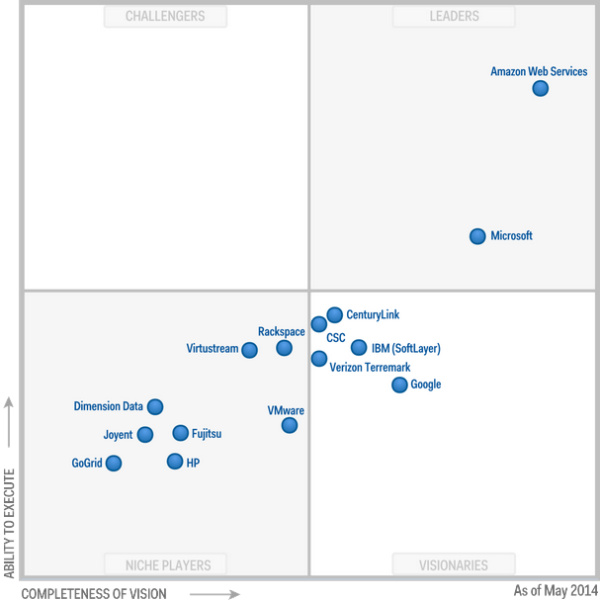
Gartner magic quadrant for IaaS providers

Slide 69
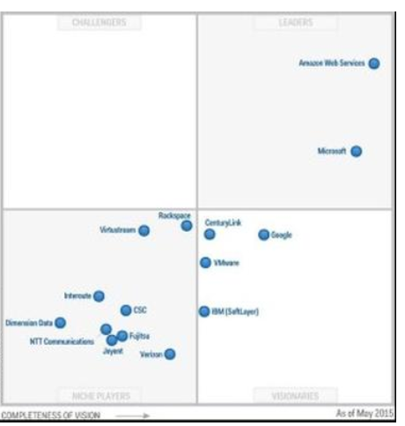
Tendencies, compare to last year (May 29, 2015)

Slide 70
Hardware providers 3/2015
According to new figures from Synergy Research Group, Cisco is the leading dealer for hardware that runs public clouds and HP gear is the most prevalent hardware for private clouds. Both companies have maintained their leads in these categories and together they make up 27% of overall revenues.
Providing infrastructure to build clouds is a hot market; total revenues were $13 billion in 2014, a 9% growth over last year.
Cisco’s lead is thanks to its dominance in the networking market, although it has a growing server business as well. HP’s lead is credited to its compute servers, with a lesser, but still prominent stake in storage and networking infrastructure.
Most surprising about the results are the drop by IBM. IBM used to be the top provider of infrastructure for clouds, at more than 16% of the market. After it’s sale of Lenovo last year though the company has dropped to less than 8% of the market, below Cisco, HP, Microsoft and Dell.

Slide 71
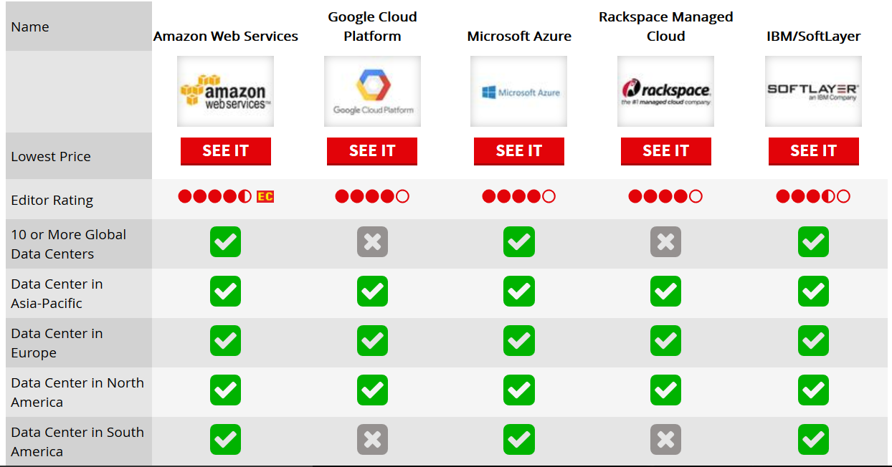
http://www.pcmag.com/article2/0,2817,2496292,00.asp 2016

Slide 72
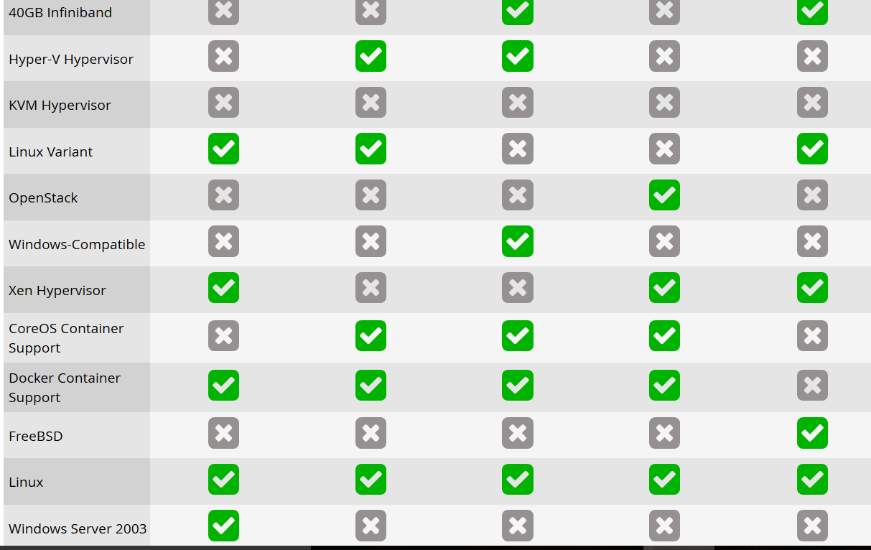

Slide 73
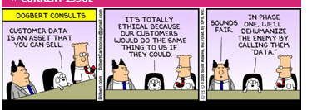
Databases

Slide 74
Databases
A DBMS is a repository of persistent data
Query and other data handling languages
Efficient storage of information
Authorization system
Concurrency control
Recovery and fault tolerance

Slide 75
Relational databases
Relational databases store their data in the form of tables, where each entry (tuple) represents a record
The relational model uses several basic (relational algebra) operations to manipulate data: selection, projection, union, minus, Cartesian product, and join
There are also rules for integrity
The basic operations can be used to define views that present the users a subset of the database
Almost all relational databases use SQL as data manipulation language (SQL is an ANSI and ISO standard).
Examples include IBM DB2, Oracle DBMS, Microsoft SQL Server, PostgreSQL, MySQL,…

Slide 76
Table descriptions

Slide 78
Transactions
A transaction is a unit of work that reads or writes the content of the DBMS
A transaction is said to commit when it completes successfully
ACID (atomicity, consistency, isolation, durability) is a set of properties that guarantee database transactions are processed reliably
For example, a transfer of funds from one bank account to another, even though that might involve multiple changes (such as debiting one account and crediting another), is a single transaction.

Slide 79
ACID properties
Atomicity requires that database modifications must follow an "all or nothing" rule. Each transaction is said to be atomic. If one part of the transaction fails, the entire transaction fails and the database state is left unchanged.
The consistency property ensures that any transaction the database performs will take it from one consistent state to another.
Isolation refers to the requirement that other operations cannot access data that has been modified during a transaction that has not yet complete
Durability is the ability of the DBMS to recover the committed transaction updates against any kind of system failure (hardware or software).

Slide 80
New databases for the cloud
Relational DBMSs put high emphasis on integrity and use ACID transactions.
They also emphasize security and have elaborated authorization systems, currently using Role-Based Access Control (to be seen later)
Typical modern relational databases have shown poor performance on certain data-intensive applications, including indexing a large number of documents, serving pages on high-traffic websites, and delivering streaming media
Typical RDBMS implementations are tuned either for small but frequent read/write transactions or for large batch transactions with rare write accesses.
Very common in the cloud now are NoSQL DBMSs, where speed is the main objective and security or reliability are not very important
NoSQL DBMSs are intended for heavy read/write workloads
Used to handle social networks and news

Slide 81
NoSQL (Not Only SQL)
DBMSs that differ from classic Relational DBMSs (RDBMSs) in that they may not require fixed tables, and usually avoid join operations and typically scale horizontally
Some NoSQL advocates promote very simple interfaces such as associative arrays or key-value pairs.
Other systems, such as native XML databases, promote support of the XQuery standard. Newer systems such as CloudTPS also support join queries.

Slide 82
Uses of NoSQL
The open source Cassandra data management system replaced the MySQL database system at Twitter, the latest of several MySQL replacements at social networking sites
Facebook and Digg, which used to rely on the open source MySQL database system, have already made the switch.
Cassandra can be run on large server clusters and is capable of taking in very large amounts of data at a time, performing sorts and calling up relevant data quickly. It's an example of the new types of data handling systems that are powering large Web applications, particularly social networking sites which deal with hundreds of thousands or millions of users.
The NoSQL movement includes Cassandra, Hadoop, Google's Big Table, MemCacheDB, Voldemort, Couchbase, MongoDB, Digg’s 3 TB, Facebook’s 50 TB for inbox search, and eBay's 2 PB overall data.

Slide 83
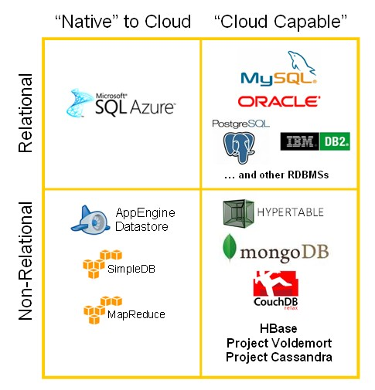

Slide 84
MongoDB
MongoDB (from humongous) is a Free and open-source cross-platform document-oriented database
Classified as a NoSQL database, MongoDB avoids the traditional table-based relational database structure in favor of JSON-like documents with dynamic schemas (It calls the format BSON), making the integration of data in certain types of applications easier and faster.
New pluggable storage engines optimized for in-memory computing and the most security-sensitive applications. Role access to resources, not data items. Database encryption.

Slide 85
Couchbase
Couchbase Server is an open-source, distributed (shared-nothing architecture) multi-model NoSQL document-oriented database software package that is optimized for interactive applications.
These applications may serve many users by creating, storing, retrieving, aggregating, manipulating and presenting data
In support of these kinds of application needs, Couchbase Server is designed to provide easy-to-scale key-value or JSON document access with low latency and high sustained throughput
It is designed to be clustered from a single machine to very large-scale deployments spanning many machines (high scalability)

Slide 86
MapReduce
A framework for processing highly distributable problems across huge datasets using a large number of computers (nodes), collectively referred to as a cluster (if all nodes use the same hardware) or a grid (if the nodes use different hardware).
Computational processing can occur on data stored either in a filesystem (unstructured) or in a database (structured).
It transforms a list of (key, value) pairs into a list of values
It is necessary but not sufficient to have implementations of the map and reduce abstractions in order to implement MapReduce. Distributed implementations of MapReduce require a means of connecting the processes performing the Map and Reduce phases. This may be a distributed file system. Other options are possible, such as direct streaming from mappers to reducers, or for the mapping processors to serve up their results to reducers that query them.
MapReduce's use of input files and lack of schema support prevents the performance improvements enabled by common database system features such as B-Trees and hash partitioning

Slide 87
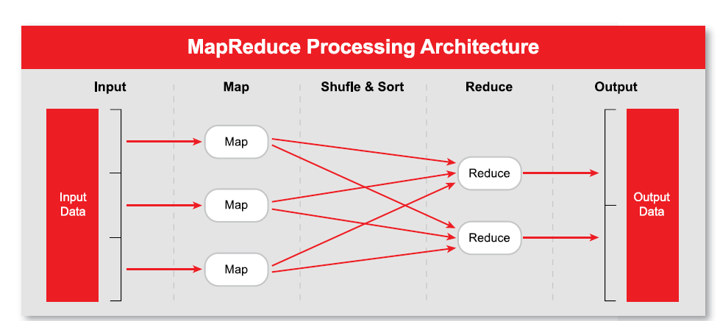

Slide 88
HADOOP
Apache Hadoop is an open source software framework that supports data-intensive distributed applications. It enables applications to work with thousands of nodes and petabytes of data.
Hadoop was inspired by Google's MapReduce and Google File System (GFS).
Hadoop is an Apache project being built and used by a global community of contributors, using Java.
Hadoop has a file system and Hadoop YARN – a resource-management platform responsible for managing compute resources in clusters and using them for scheduling of users' applications.
Yahoo has been the largest contributor to the project, and uses Hadoop extensively across its businesses. Facebook, eBay, Netflix, and LinkedIn also use it.
""Hadoop: The Definitive Guide," by T. White. O'Reilly Media Inc., 2009

Slide 89
HDFS File system
The HDFS is a distributed, scalable, and portable file system written in Java for the Hadoop framework.
Each node in a Hadoop instance typically has a single datanode; a cluster of datanodes forms the HDFS cluster.
But each node does not require a datanode to be present. Each datanode serves up blocks of data over the network using a block protocol specific to HDFS.
The filesystem uses the TCP/IP layer for communication; clients use RPC to communicate with each other. The HDFS stores large files (an ideal file size is a multiple of 64 MB), across multiple machines.
It achieves reliability by replicating the data across multiple hosts, and hence does not require RAID storage on hosts.
With the default replication value, 3, data is stored on three nodes: two on the same rack, and one on a different rack. Data nodes can talk to each other to rebalance data, to move copies around, and to keep the replication of data high.
The HDFS is not fully POSIX compliant because the requirements for a POSIX filesystem differ from the target goals for a Hadoop application. The tradeoff of not having a fully POSIX compliant filesystem is increased performance for data throughput. The HDFS was designed to handle very large files. The HDFS does not provide high availability.

Slide 90
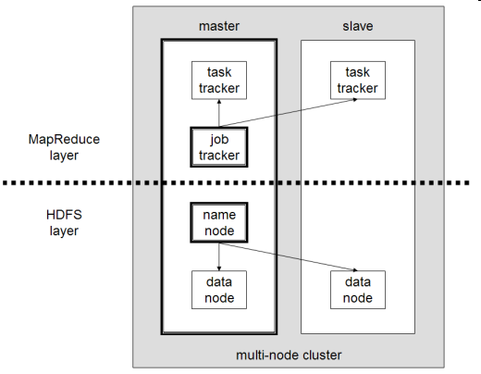
A multinode HADOOP cluster

Slide 91
HADOOP supported file systems
HDFS: Hadoop's own rack-aware filesystem. This is designed to scale to tens of petabytes of storage and runs on top of the filesystems of the underlying OSs.
Hadoop allows you to specify that master data and replicated data are not stored on servers in the same hardware failure group. This feature is called rack awareness.
Amazon S3 file system. This is targeted at clusters hosted on EC2 infrastructure.
CloudStore (previously Kosmos Distributed File System), which is rack-aware.
FTP Filesystem: this stores all its data on remotely accessible FTP servers.
Windows Azure storage blobs
Read-only HTTP and HTTPS file systems.

Slide 92
Lexis Nexis www.hpccsystems.com
LexisNexis has more than 35 years experience in managing big data, from publicly available information such as worldwide newspapers, magazines, articles, research, case law, legal regulations, periodicals, and journals – to public records such as bankruptcies, liens, judgments, real estate records – to other types of information.
To manage, sort, link, and analyze billions of records LexisNexis Risk Solutions designed a data intensive supercomputer built on their own High Performance Cluster Computing (HPCC) platform able to sort through billons of records. Customers such as banks, insurance companies, utilities, law enforcement, and Federal government may use LexisNexis technology and information solutions to help them make better decisions faster. The supercomputing platform is available as an open source solution called HPCC Systems, and is an alternative to Hadoop.
The Enterprise Control Language (ECL),is a declarative, data-centric programming language optimized for large-scale data management and query processing, automatically manages workload distribution across all nodes. It also manages all aspects of the massive data joins, sorts and builds.

Slide 93
Lexis Nexis High Performance Computer Cluster (HPCC)
http://www.computerworld.com/s/article/9222938/Hadoop_challenger_works_to_add_developers
LexisNexis has worked for more than a decade to develop a large scale system for Big Data manipulation, and it believes that it has produced something that's better and more mature than the better known Hadoop technology.
To help demonstrate its capabilities, a Terasort benchmark was run to compare HPCC against a similar benchmark and workload by SGI on a Hadoop cluster, announced in October.
LexisNexis says its benchmark was 25% faster, and ran on far less hardware: A 4-node cluster versus a 20-node cluster on the SGI system. The LexisNexis test was done on a Dell PowerEdge, two socket servers, with six core Intel Xeon processors.
The company has made its HPCC system available in the cloud via Amazon Web Services.
http://hpccsystems.com/Why-HPCC/How-it-works

Slide 94
HPCC Units
HPCC uses clusters of hardware and includes custom system software and middleware components developed and layered on a base Linux operating system to provide the execution environment and distributed filesystem support required for data-intensive computing [Bay11, HPC].
Thor, (the Data Refinery Cluster), is responsible for consuming vast amounts of data, transforming, linking and indexing that data. It functions as a distributed file system with parallel processing power spread across the nodes. A cluster can scale from a single node to thousands of nodes.
Roxie (the Query Cluster), provides separate high-performance online query processing and data warehouse capabilities.
ECL (Enterprise Control Language) is a programming language that manipulates the data. It is a non-procedural and dataflow oriented language.
There are also appropriate tools to support programmers, to interface with web services, and to apply web services security standards

Slide 95
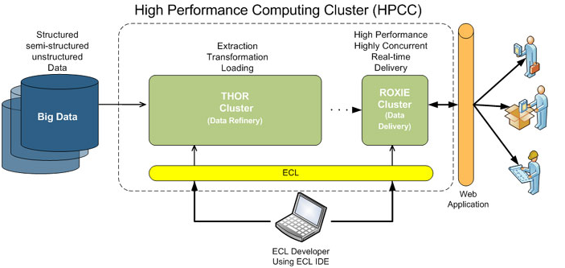

Slide 96
Amazon’s DynamoDB http://www.allthingsdistributed.com/2012/06/amazon-dynamodb-growth.html
Fast and scalable NoSQL database service, has been setting AWS growth records.
Customers have used DynamoDB to support Super Bowl advertising campaigns, drive Facebook applications, collect and analyze data from sensor networks, track gaming information, and more.
It has authentication and access control
Customers such as Electronic Arts, News International, SmugMug, Shazam, IMDb, Amazon Cloud Drive, and many others are using DynamoDB to power their applications.

Slide 97
Aster Data Systems
Aster Data's nCluster is a massive parallel processing analytic database management system that runs on a cluster of commodity servers. The architecture of Aster nCluster is optimized for data warehousing and analytic applications, also called Online analytical processing (OLAP) as opposed to Online Transaction Processing (OLTP).
Aster Data created a framework called SQL-MapReduce that allows the Structured Query Language (SQL) to be used with the MapReduce technology from Google.
An early large customer of Aster Data Systems was MySpace, which used the product primarily for clickstream analysis by 2008. Other clients include comScore, LinkedIn, Share This, Intuit, Akamai, and Full Tilt Poker.
In October 2013, version 6 of Aster database software was announced. It supported graph database technology, and a file system that the company said was compatible with the Hadoop distributed filesystem.

Slide 98
Google App Engine's datastore
Google App Engine's datastore has a SQL-like syntax called "GQL".
GQL intentionally does not support the Join statement, because it seems to be inefficient when queries span more than one machine. Instead, one-to-many and many-to-many relationships can be accomplished using ReferenceProperty().
This shared-nothing approach allows disks to fail without the system failing.
Switching from a relational database to the Datastore requires a paradigm shift for developers when modeling their data.
Datastore is not relational in the SQL sense.
Cloud Datastore provides capabilities such as ACID transactions, SQL-like queries,a and indexes.
Google Cloud SQL
In Oct 2011, Google previewed a zero maintenance SQL database, which supports JDBC and DB-API. This service allows to create, configure, and use relational databases with App Engine applications. The database engine is MySql Version 5.1.59 and the database size must be no larger than 10GB.

Slide 99
Criticism
David DeWitt and Michael Stonebraker have been critical of the breadth of problems that MapReduce can be used for.
They called its interface too low-level; they also compared MapReduce programmers to Codasyl programmers, noting both are "writing in a low-level language performing low-level record manipulation”
DeWitt and Stonebraker have subsequently published a detailed benchmark study in 2009 comparing performance of Hadoop's MapReduce and RDBMS approaches on several specific problems. They concluded that databases offer real advantages for many kinds of data use, especially on complex processing or where the data is used across an enterprise, but that MapReduce may be easier for users to adopt for simple or one-time processing tasks. They have published the data and code used in their study to allow other researchers to do comparable studies.
But unstructured data is a majority and does not fit well RDBMSs

Slide 100
Issues of Data Storage Services in the cloud
Advantages
– Data fragmentation and dispersal—can be useful for security and local use
– Automated replication—fault tolerance
– Provision of data zones (e.g., by country)
– Encryption at rest and in transit
– Automated data retention—legal issues and compliance
Challenges
– Isolation management / data multi-tenancy
– Storage controller is single point of failure (share nothing architectures are good for this purpose)
– Exposure of data

Slide 101
Cloud news 03/2011
Amazon's cloud storage service has unveiled a brand new way to quickly move giant amounts of data to the cloud, one so technologically advanced that it actually allows customers to "bypass the Internet."
What is this new technology, you may ask? It's called FedEx. For large amounts of data, terabytes, it could actually take weeks to upload to Amazon's servers over the Internet. So Amazon is now letting customers put a storage device in the mail and Amazon will take care of the data transfer within its own high-speed internal network

Slide 102
Data exchange
XML is used to transfer documents to/from services; documents may have complex structures
JSON transfers simple data structures to/from services
JSON is faster but not self-descriptive, not so rich, not very secure

Slide 103
Uses of XML
Can describe and transport any logical view’s data. Uses semantic tags.
Application partitioning, move processing from server to client.
Present different views of the same data to different users.
Implement intelligent agents that tailor information to the needs of users.
Support contractual relationships, e.g., delivery constraints.
Can define elaborate security constraints
9/21/2016
103

Slide 104
XML views
XML documents use tags
DTD (Document Type Definition)—Defines meaning of tags in the document,
XSL (Style Sheet)—Defines layout for data.
XML Schema—Similar to database schemas.
DOM—A tree view of document structure.
9/21/2016
104

Slide 105
XML Document Example
<?xml version="1.0"?> //self-descriptive
<note> //semantic tag
<to>Anna</to>
<from>Ed</from>
<heading>Reminder</heading>
<body>Don't forget your art class</body>
</note>

Slide 106
JSON
JavaScript Object Notation is a lightweight text-based open standard designed for human-readable data interchange. It is derived from the JavaScript programming language for representing simple data structures and associative arrays, called objects.
Despite its relationship to JavaScript, it is language-independent, with parsers available for most programming languages.
The JSON format was originally specified by Douglas Crockford, and is described in RFC 4627. The official Internet media type for JSON is application/json. The JSON filename extension is .json.
The JSON format is often used for serializing and transmitting structured data over a network connection. It is primarily used to transmit data between a server and web application, serving as an alternative to XML.

Slide 107
SOAP
Originally defined as Simple Object Access Protocol, is a protocol specification for exchanging structured information in the implementation of Web Services in computer networks.
It relies on Extensible Markup Language (XML) for its message format, and usually relies on other Application Layer protocols, most notably Remote Procedure Call (RPC) and Hypertext Transfer Protocol (HTTP), for message negotiation and transmission
SOAP can form the foundation layer of a web services protocol stack, providing a basic messaging framework upon which web services can be built. This XML based protocol consists of three parts: an envelope, which defines what is in the message and how to process it, a set of encoding rules for expressing instances of application-defined datatypes, and a convention for representing procedure calls and responses.

Slide 108
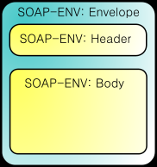
SOAP

Slide 109
REST
Representational State Transfer (REST) is a style of software architecture for distributed hypermedia systems such as the World Wide Web
REST exemplifies how the Web's architecture emerged by characterizing and constraining the macro-interactions of the four components of the Web, namely origin servers, gateways, proxies and clients, without imposing limitations on the individual participants.
REST-style architectures consist of clients and servers. Clients initiate requests to servers; servers process requests and return appropriate responses. Requests and responses are built around the transfer of representations of resources. A resource can be essentially any coherent and meaningful concept that may be addressed. A representation of a resource is typically a document that captures the current or intended state of a resource.

Slide 110
REST
Transport protocols
The FUSE Message Broker’s REST protocol is based on a subset of the HTTP protocol. Hence, HTTP is the only supported transport.
Supported clients
REST supports the following client types:
Web forms—use conventional HTML forms to POST a message to a destination (queue or topic) or to GET a message from a destination—see Example of posting a message .
Ajax clients—an Asynchronous JavaScript And Xml (Ajax) library that enables you to communicate with a REST endpoint using JavaScript in a DHTML Web page. For details of how to program an Ajax client, see the Cross Language Client Development Guide.
REST servlets
The REST protocol is implemented by the following servlets running in a Web container:
message servlet—supports the sending and consuming of messages.
queueBrowse servlet—enables you to view the current status of a particular queue.

Slide 111
REST and web services
A RESTful web service (also called a RESTful web API) is a simple web service implemented using HTTP and the principles of REST. It is a collection of resources, with three defined aspects:
the base URI for the web service, such as http://example.com/resources/
the Internet media type of the data supported by the web service. This is often JSON, XML or YAML but can be any other valid Internet media type.
the set of operations supported by the web service using HTTP methods (e.g., POST, GET, PUT or DELETE).
A good overview:
A. Rodriguez, “RESTful web services: the basics”
http://www.ibm.com/developerworks/webservices/library/ws-restful/

Slide 112
Notation
A Uniform Resource Identifier (URI) is a string of characters used to identify a name or a resource on the Internet. Such identification enables interaction with representations of the resource over a network (typically the World Wide Web) using specific protocols.
JSON (an acronym for JavaScript Object Notation is a lightweight text-based open standard designed for human-readable data interchange. It is derived from the JavaScript programming language for representing simple data structures and associative arrays, called objects. Despite its relationship to JavaScript, it is language-independent, with parsers available for virtually every programming language.
YAML is a human-readable data serialization format that takes concepts from programming languages such as C, Perl, and Python, and ideas from XML and the data format of electronic mail (RFC 2822)

Slide 113
REST or SOAP?
Most of the web functionality on the Internet now uses REST: Twitter, Yahoo’s web services use REST, others include Flickr, del.icio.us, pubsub, bloglines, technorati, and several others. Both eBay and Amazon have web services for both REST and SOAP.
SOAP is mostly used for Enterprise applications to integrate wide types and no. of applications and another trend is to integrate with legacy systems, etc. Google is consistent in implementing their web services using SOAP, with the exception of Blogger, which uses XML-RPC.
REST is a low-level protocol and cannot enforce precise security

Slide 114
Web Services
A Web Service is a type of component that is available on the web and can be incorporated in applications or used as a standalone service
Requires a standard supporting framework
The web could become a marketplace of web services (intended but never happened)

Slide 115
Use of web services

Slide 116
New layers
Web services introduce three more architectural layers
These layers run on top of communication protocols (SOAP or REST) for transmission and on top of databases and operating systems for storage and processing
New layers add functionality but also complexity

Slide 117
Web services layers

Slide 118
Functionality standards
Each layer has a set of standards
BPEL Business Processing Language
WSDL and UDDI to find services
SOAP/REST for communication
XML to describe documents
There are also protocols for security, reliability, trust, and policies (non-functional aspects)

Slide 119
Web services standards

Slide 120
Patterns for web services
The layers of web services are an instance of the Layers pattern
A portal where users can find services corresponds to a Façade pattern
Separation of XML interfaces from implementations correspond to Bridge patterns

Slide 121
The Layers pattern.
Its main idea is the decomposition of a system into hierarchical layers of abstraction, where the higher levels use the services of the lower levels
The operations in level i are implemented in terms of the operations in level i-1
It is more than a pattern, it is a fundamental architectural principle, used in operating systems, networks, applications, and all kind of software
Context. A complex system that requires decomposition.
Problem. Systems where all modules call any other module and where high-level aspects are mixed with low-level aspects are hard to understand, hard to modify, and hard to test. Complex systems require a systematic and organized structure.
Solution. Build a hierarchy of layers where Layer i depends on Layer i-1.

Slide 122
Typical layers

Slide 123
Three-tier pattern
A common way to apply the Layers pattern is the three-tier architecture
This includes: a presentation layer (user/application interfaces), a business layer (global enterprise model), a storage layer (mappings to databases)
In addition to modularity and well-defined interfaces, the three-tier architecture is intended to allow any of the three tiers to be upgraded or replaced independently as requirements or technology change
A generalization of the idea is the four-tier architecture or even N-tier or multitier architecture

Slide 124
UC: request data or service
:Client
:Presentation
:Business
:Data
requestAccess()
processRequest
authorizeAccess()
getAccessSupport()
returnResults()
grantAccess()
applyRules
grantAccess()
doTask()
processTask
callOperation()
applyRules /
processTask()
doProcedure()
returnResults()
processData
returnResults()
returnResults()

Slide 125
Façade
Intent: Provide a unified higher-level interface to a set of interfaces in a subsystem.
Applicability: Use Façade when you want to provide a simple interface to a complex object-oriented subsystem or you want an entry point to a layer in a layered system.

Slide 126
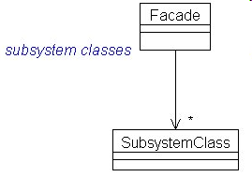
Façade class diagram

Slide 127
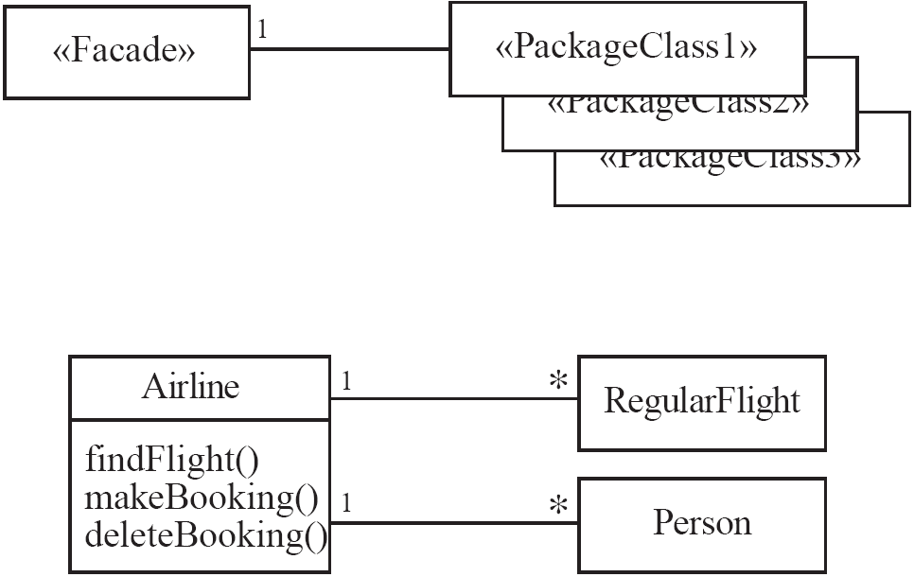
Façade
Solution:

Slide 128
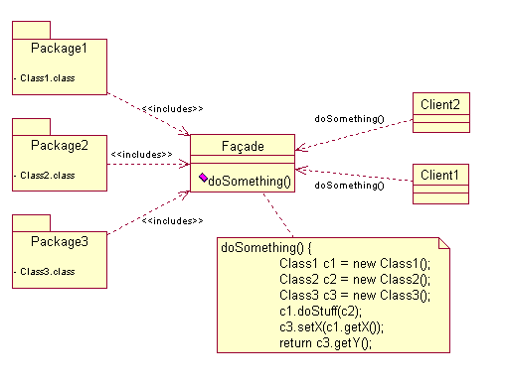
http://upload.wikimedia.org/wikipedia/commons/a/ac/FacadeDesignPattern.png

Slide 129
Consequences
Shields clients of details from subsystem units
Units in the subsystems can vary without affecting clients
Can improve security and reliability by hiding implementation details

Slide 130
Bridge
Decouple an abstraction from its implementation so that the two can evolve independently.
This is a basic pattern for components and web services
Example: a web service has an XML wrapping and an implementation written in any language

Slide 132
Consequences
The Abstraction and the Implementation can be extended independently
The implementation can be dynamic, i.e, configured or changed at run time.
Hiding implementation improves security and reliability

Slide 133
Refs. For Ch. 5
[Ama] Amazon Web Services LLC, “Amazon Elastic Compute Cloud (Amazon EC2)”, http://aws.amazon.com/ec2
[Daw] W. Dawoud, I. Takouna, and C. Meinel, “Infrastructure as a Service Security: Challenges and Solutions”, the 7th International Conference on Informatics and Systems, 2010
[For] Force Platform, “Force Platform”, http://forceplatform.com/
[GoG] GoGrid, “How GoGrid works”, http://www.gogrid.com
[Hut10] G. Hutch, “Getting the most out of Virtualization”, The Architecture Journal, http://msdn.microsoft.com/en-us/architecture/ff803574.aspx
[Nur09] D. Nurmi, et al., “The Eucalyptus Open-source Cloud-computing system”, 9th IEEE/ACM Int. Symposium on Cluster Computing and the grid, 2009, 124-131.
[VMw] VMware, http://www.vmware.com
[You08] L. Youseff, M. Butrico, and D. Da Silva, “Toward a Unified Ontology of Cloud Computing”, Grid Computing Environments Workshop 2008 (GCE’08)

Slide 134
Ch.5 Refs.
E.B.Fernandez, Raul Monge, and Keiko Hashizume, “Building a security reference architecture for cloud systems”, Requirements Engineering. Doi: 10.1007/s00766-014-0218-7, 2015
E. B.Fernandez and Brahim Hamid, “A pattern for Network Functions Virtualization”, 21st European Conf. on Pattern Languages of Programs (EuroPLoP 2015)
E.B.Fernandez, H. Yashizaki, N. Yoshioka, “Patterns for Secure Cloud IaaS”, 5th Asian Conference on Pattern Languages of Programs” (AsianPLoP 2016).
Gernot Heiser and Ben Leslie. “The OKL4 Microvisor: Convergence point of microkernels and hypervisors”. Proceedings of the 1st Asia-Paciﬁc Workshop on Systems (APSys), pp. 19–24, New Delhi, India, August 2010.

